Slide 1

卒業プロジェクト – Capstone Project
Useful Japanese Dictionary for Vietnamese
スーパーバイザ: Nguyễn Văn Sang Supervisor リーダー: Lê Đình Nam – SE02316 Leader メンバー: Phạm Thị Minh – SE02300 Member Phạm Tiến Đạt – SE02336 Nguyễn Ngọc Tuấn – SE02189

Slide 2
コンテンツの概要 – Outline of Content
1. 導入 – Introduction
2. プロジェクト管理 – Project Management
3. ソフトウェア要求仕様 – Software Requirement Specification
4. ソフトウェア設計説明書 – Software Design Description
5. 品質管理 – Quality Control
6. プロジェクト結果 – Project Result
7. デモ – Demo
8. 質問と回答 – Q & A

Slide 3
1.導入 - Introduction
1.2 在のウェブサイト - Existing Websites
1.3 アイデア - Idea
1.4 提案 - Proposal
1.1 現在状況 - Current Situation

Slide 4
1.1 現在状況 - Current Situation
現在日本語の勉強は注目されています - Learning Japanese is trend nowadays
ラーニング のオンライン のウェブサイトがたくさん有る - There are more online learning websites
BUT
ベトナムにウェブサイトがあまり無い。殆どはトレーニングのセンタのウェブサイト、そして学ぶためにユーザが アカウントをアップグレードする必要があります - Website of Vietnam not much. Almost is website of training center and it requires upgrading account to learn
無料だったら、ウェブサイトはドキュメントがゆたかではでなく、皆さんにも適していません。- If free, website does not abundant document and not suitable for everyone

Slide 5
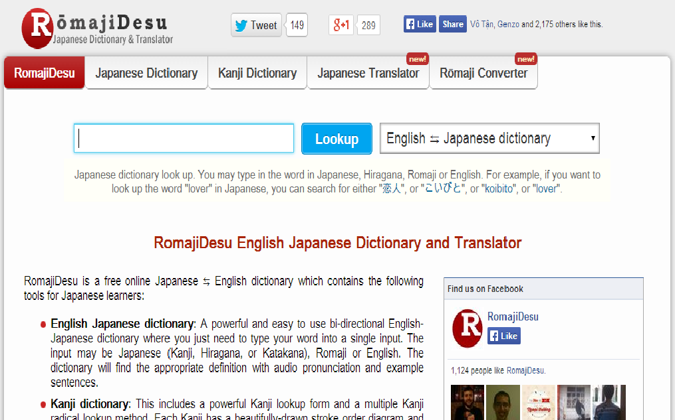
1.2 在のウェブサイト - Existing Websites
☺探すのに広大なデータベースが有る。特別は漢字だ - Having a huge database to search. Specially KANJI
BUT
英語 – Only English language
ドキュメントのサポートがない No support reading document
プラクティスのサポートがない No support practice
会話のサポートがない No support listening conversation
http://www.romajidesu.com

Slide 6
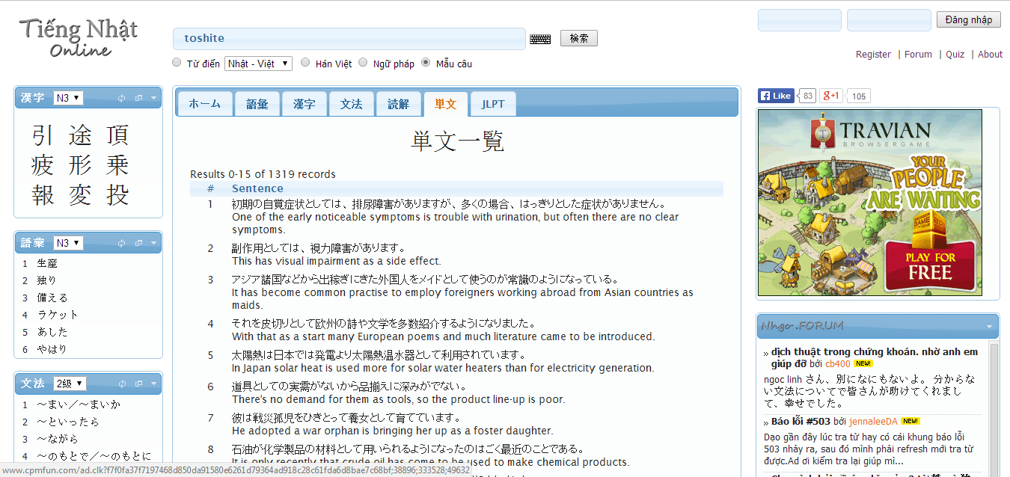
1.2 在のウェブサイト - Existing Websites
☺ より多くオプションで探す。しかしベトナム語の意味がない - Search with more option.
But some word don’t have Vietnamese meaning
☺質問のポストのサポート - Support post question
BUT
ベトナム - 日本の辞書がない No support Viet - Nhat dictionary
会話がない
No support listening conversation
広告がユーザにノイズの多い作る Advertisement make noisy
http://www.nhgo.net

Slide 7
1.3 アイデア - Idea
ウェブサイト を展開する - Build a website with:
ベトナム語 - Vietnamese language
皆さんに適する - Suitable for everyone, from beginner
すっかり無料だ - 100% Free
全ての機能のサポート - Support full features
全てのレベルのサポート: N5 ->N1 - Support full levels: N5 ->N1

Slide 8
1.4 提案 - Proposal
ベトナムごのサポート - Support Vietnamese language
優しいインターフェース - Friendly interface
ユーザが アカウントをアップグレードする必要がない - No need upgrading account
より多くオプションで探す - Search with more option
より多くドキュメントを読む - Reading more documents type
会話を聞く - Listening conversation
練習のサポート - Practice
ユーザから 寄付を得る - Receive contributions from user

Slide 9
2.プロジェクト管理 - Project Management
2.1 ソフトウェ アプロセス モデル - Software Process Model
2.2 プロジェクト組織 - Project Organization
2.3 プロジェクト計画 - Project Schedule
2.4 目標 と 成果物 - Objectives & deliverables
2.5ツールと インフラストラクチャ - Tools & Infrastructure
2.6リスク管理 - Risks management
2.7 コンフィグレーション管理 - Configuration management
2.8 コミュニケーション管理 - Communication management

Slide 10
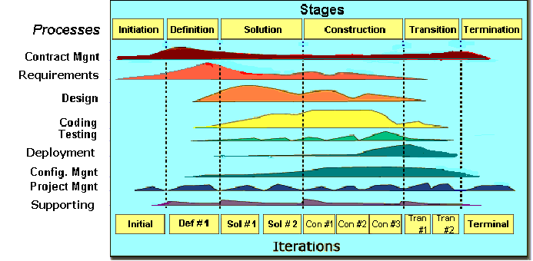
2.1 ソフトウェ アプロセス モデル Software Process Model

Slide 11
2.1 ソフトウェ アプロセス モデル Software Process Model
Initiation | Identify business functions of the system Determine scope, condition, limitation, project risk List main functions Complete Report #1, Report #2
Solution | Complete SRS Design Document Complete Report #3, Report #4
Construction | Complete Coding and Testing Complete software packages and Report #5, Report #6
Termination | Product will be deployed to the client Preparing presentation Complete Project
プロジェクトのライフサイクル - Project Life Cycle

Slide 12
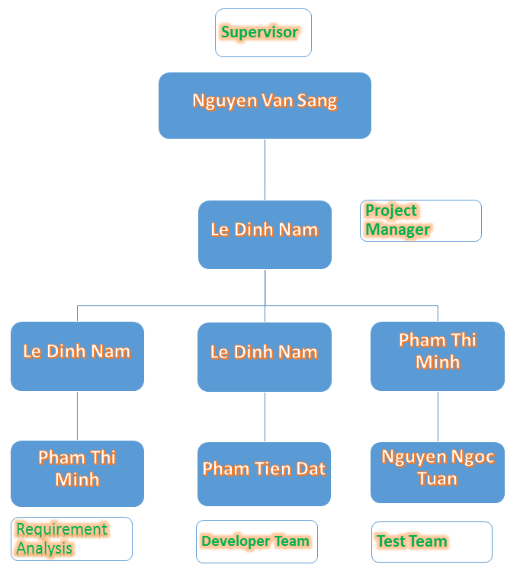
2.2 プロジェクト組織 - Project Organization

Slide 13
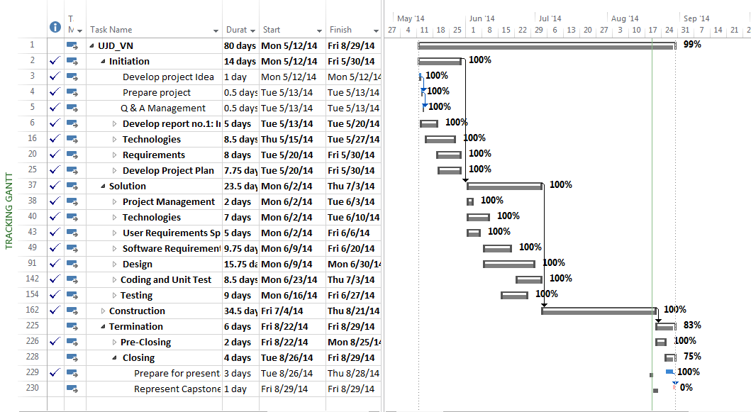
2.3 プロジェクト計画 - Project Schedule

Slide 14
2.4 マイルストーンの成果物 – Deliverables Milestone
No | Stage | Committed Delivery date | Description of Deliverable | Delivery media
Initiation |  |  | Requirements agreed, Report 1 reviewed
1 | Submit Project Introduction | 20-05-2014 | Completed Project Introduction | Commit SVN
2 | Submit Project Plan Final | 28-05-2014 | Criteria: Documentation reviewed | Commit SVN
Solution
1 | Architecture Design | 12-06-2014 | Criteria: Documentation reviewed | Commit SVN
2 | Screen Design | 10-06-2014 | Criteria: Documentation reviewed | Commit SVN
3 | Class Design | 11-06-2014 | Criteria: Documentation reviewed | Commit SVN
4 | Data Design | 11-06-2014 | Criteria: Documentation reviewed | Commit SVN
5 | SRS Final | 20-06-2014 | Criteria: Documentation reviewed | Commit SVN
Construction |  |  | Product developed & tested and released to supervisor, documentation reviewed.
1 | Submit Test Plan Final | 23-06-2014 | Completed report no.5 | Commit SVN
2 | Complete Coding and Unit Test | 24-07-2014 | Source code Acceptance criteria: Product unit tested | Commit SVN
3 | Complete Testing | 31-07-2014 | Completed Test | Commit SVN
4 | Submit User Manual Final | 11-08-2014 | Completed report no.6 | Commit SVN
5 | Submit the last document and CD source code | 21-08-2014 | Final Documents and Source Code | Copy to CD and commit
Termination |  |  | Project post-mortem is conducted, Project assets archived and released to supervisor
1 | Represent capstone project | 30-08-2014 | Criteria: Completed | Presentation
2 | Project Complete | 30-08-2014 | Criteria: Completed

Slide 15










2.5ツールと インフラストラクチャ Tools & Infrastructure
ツール - Tools
プロジェクト管理にツール - Tools for project management
開発にツール - Tools for developing
TortoiseSVN
Word 2013
Excel 2013
Project 2013
Power Point 2013
Sublime Text 3
Chrome
Creately.com
Xampp
Atash

Slide 16
2.6リスク管理 - Risks management
Risk ID | Risk Source | Risk Category | Risk Description | Probability | Impact | Exposure | Priority | Trigger | Risk Status | Mitigation | Contingency | Person in charge
R01 | Skill Language | Insufficient business knowledge | Quality of document which is wrote by Japanese maybe not good | 0.3 | 2 | 0.6 | 4 | Member don’t know more Japanese. | Open | 1. Create plan to training Japanese for member from beginning of project. |  | Team member
 |  |  |  |  |  |  |  |  |  | 2. Using English instead of Japanese (if can). |  | Team member
 |  |  |  |  |  |  |  |  |  | 3. When deliver documents to customer can write by two languages: English and Japanese. |  | Team member

Slide 17
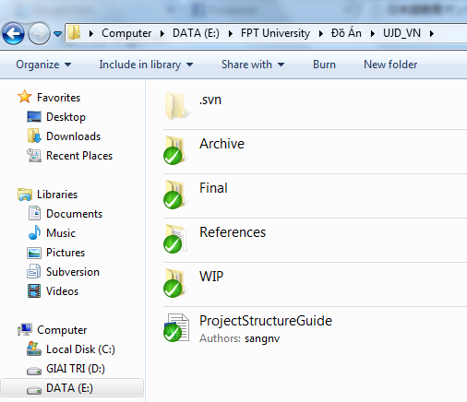
2.7 コンフィグレーション管理 Configuration management
Archive: Store baseline documents
Final: Store sent and delivered documents
References: Store reference documents. For example: templates, technologies document…
WIP: Store documents in progress developing
Plan: Plan of capstone project
Users: Working Folder of Member
Documents: Store whole documents in progress developing
Records: Store documents like Meeting Minutes, Q & A Management…
プロジェクトのフォルダ構造 – Folder structure of project

Slide 18
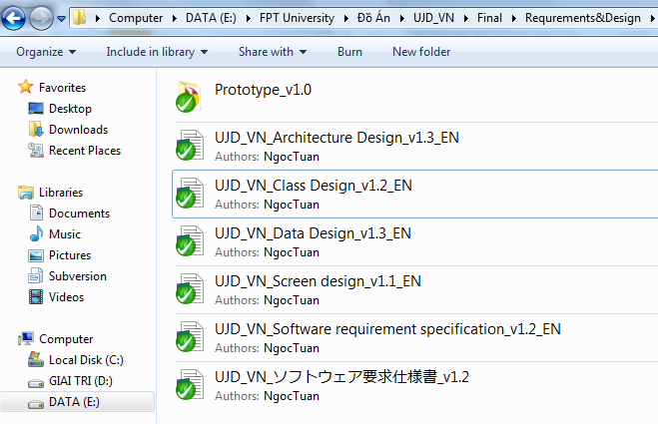
2.7 コンフィグレーション管理 Configuration management
Rule: ProjectCode_Document’s name_v<x.x>_language
ProjectCode: UJD_VN
Document’s name: Architecture Design, Class Design…
v<x.x>: document’s version. For example: v1.0, v1.1,…
Language:
EN: English
JP: Japanese
命名規則 – Naming conventions

Slide 19
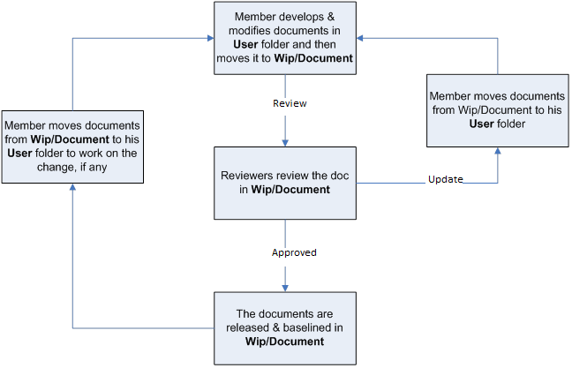
2.7 コンフィグレーション管理 Configuration management
ドキュメント - Document

Slide 20

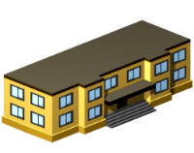






2.8 コミュニケーション管理 Communication management
労働時間 : 8時間/日、5日/週 - Time: 8 hours/day, 5 days/week.
場所 : 学校、家庭 - Location: school, home
コミュニケーション - Communication
ミーティング議事録 - Meeting minutes

Slide 21
3. ソフトウェア要求仕様 Software Requirement Specification
システムのユーザ - System Users
3.3
機能要求 - Functional Requirements
3.4
非機能要求 - Non-Functional Requirements
3.1
3.2
ビジネスプロセ - Business Process

Slide 22
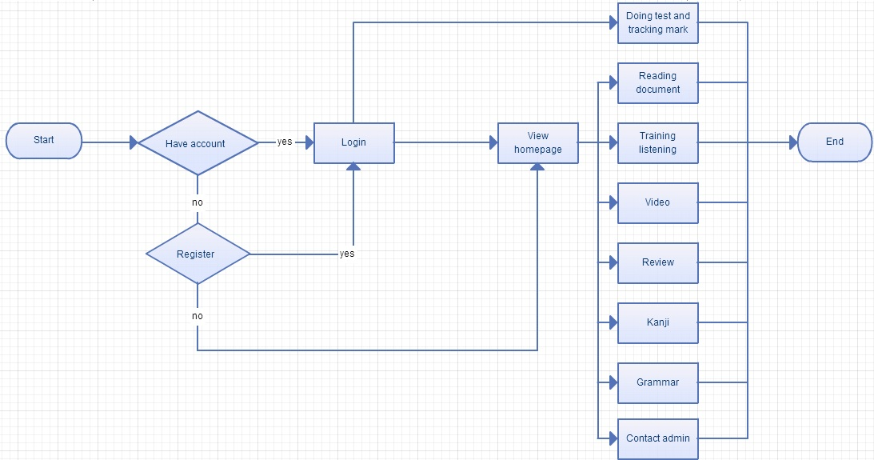
3.1 ビジネスプロセ - Business Process

Slide 23


3.2 システムのユーザ - System Users
2役者があります - There are 2 actors:
ユーザー
User
管理者
Administrator

Slide 24
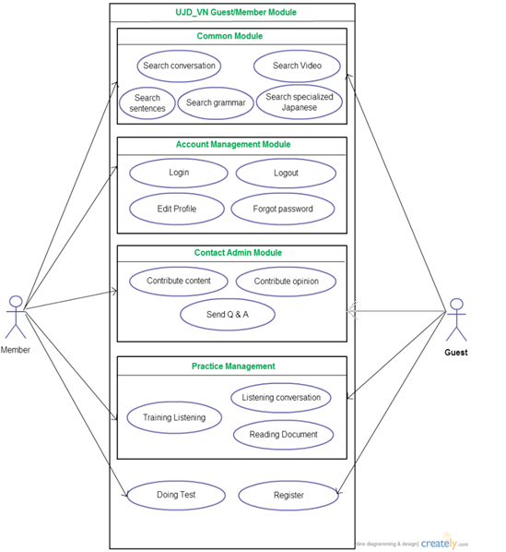
3.3 機能要求 - Functional Requirements
User Module
アカウントの管理 - Manage Account
コモン·モジュール - Common module
コンタック·アドミン - Contact admin
プラクティス·マネージメント - Practice management
ユーザーのユースケース - User use-case
全部: 17ユースケース - Total: 17 use-case

Slide 25
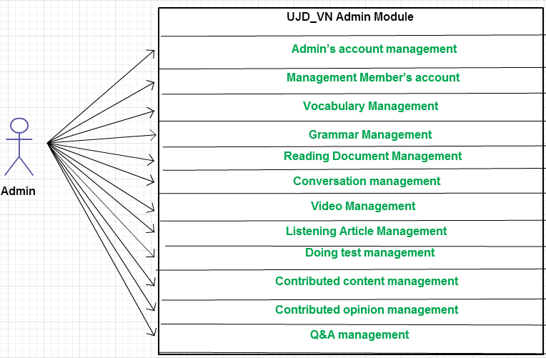
3.3 機能要求 - Functional Requirements
Admin Module
データベースマネージメント
Database management
コンタクトマネージメント
Contact management
管理のユースケース - Admin use-case
全部 ：39 ユースケース - Total: 39 use-cases

Slide 26
3.4非機能要求 - Non-functional Requirements
1.ユーザーインターフェース - User Interfaces
友好的で簡単な界面 - Friendly and simply interface
色が上品で、派手ではありません - The color is elegant, not flashy
言語はベトナム語と日本語です - Language is Vietnamese, Japanese

Slide 27


3.4非機能要求 - Non-functional Requirements
2.ソフトウェア要求 - Software Requirements
Chrome 35
Coc Coc 35
MySQL 5.1
Xampp 1.8

Slide 28
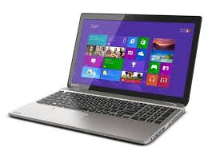


3.4非機能要求 - Non-functional Requirements
3. ハードウェア要求 - Hardware Requirements
PC, ラップトップは インターネット接続があります。
PC, Laptop with internet connection.

Slide 29
3.4 非機能要求 - Non-Functional Requirement
4. 確実 - Reliability
失敗の間 - Mean time between failures : about 480 hours
修復の間 - Mean time to repair : average 1 day.
5. 実行·要件 - Performance Requirements
可用性 - Availability : available 95% of time
切り換え時 - Response time: waiting time of processing will be 2 to 5 seconds; time to process any functions will not exceed 7 seconds.
6. ユーザビリティ - Usability
使用効率 - Efficiency of use : complete each function in less than 12 actions
直観 - Intuitiveness
7. 担保要件 - Security Requirements
ユーザー層 - User layer
データ層マネジ - Manage Data Layer
蓄えたデータ - Stored Data

Slide 30
4. ソフトウェア設計記述 Software Design Description
4.1
テクノロジー と 理由 - Technology & Reason
4.2
アーキテクチャ表現 - Architecture Representation
4.3
パッケージ ビュー - Package View
4.4
詳細設計 - Detail Design
4.5
データベース設計 - Database Design

Slide 31
4.1 テクノロジー と 理由 - Technology & Reason
テクノロジー - Technology:
PHP, Codeigniter Framework
理由 - Reason:
UJD_VNシステムと一致する
Consistent with UJD_VN system
MVCモデルに基づいて設計
Designed according to the MVC Model

Slide 32
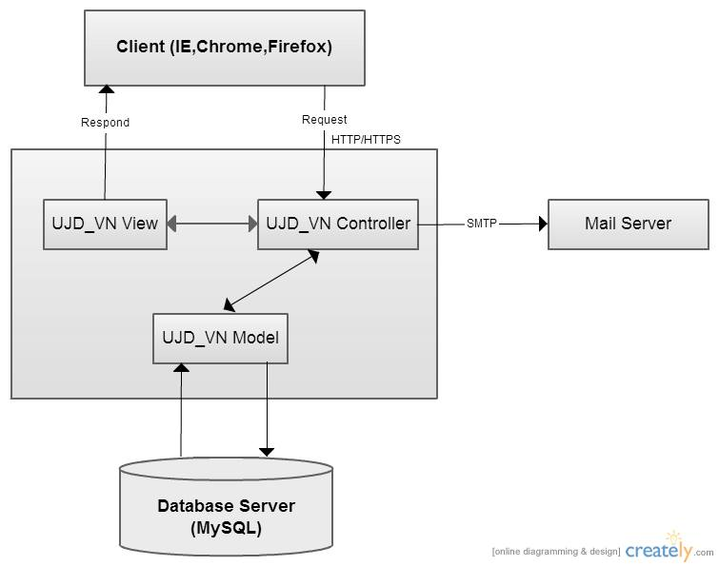
4.2アーキテクチャ表現 -Architecture Representation
UJD_VN システム全体のアーキテクチャ
UJD_VN system overall architecture

Slide 33
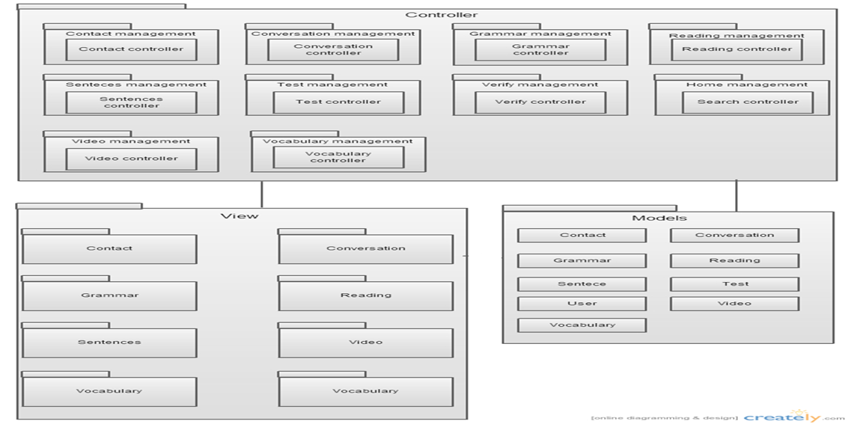
4.3 パッケージ ビュー - Package View
パッケージ ビュー - Package View

Slide 34
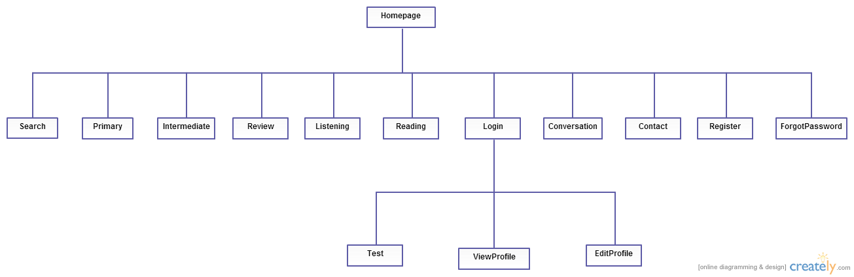
4.4.1 画面設計 - Screen Design
メインアプリケーションの画面の流れ
Main Application screen flow

Slide 35
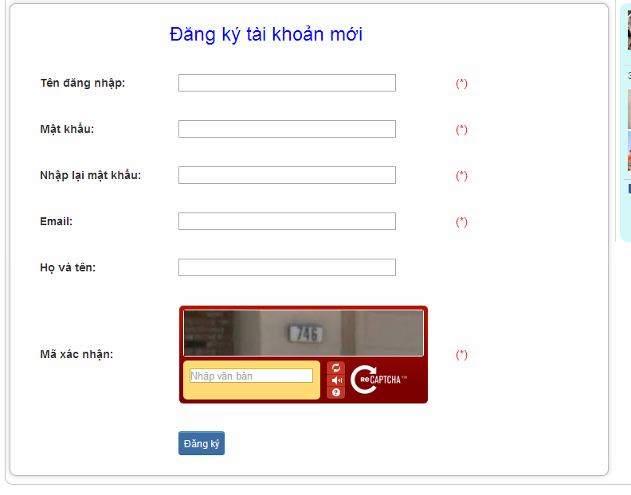
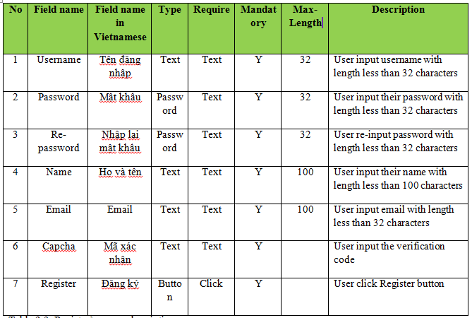
4.4.1 画面設計 - Screen Design
レジスターの画面設計 - Register screen design

Slide 36
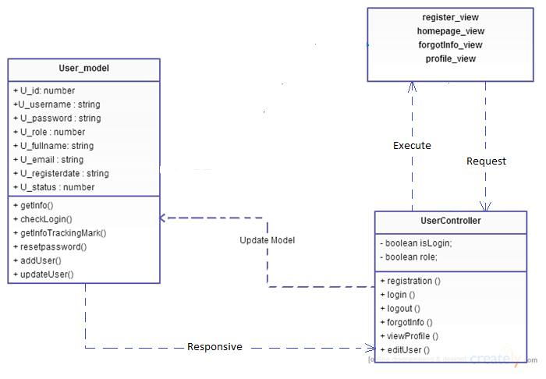
4.4.2 クラス設計 - Class Design
アカウント管理クラス設計 - Account Management Class Design

Slide 37
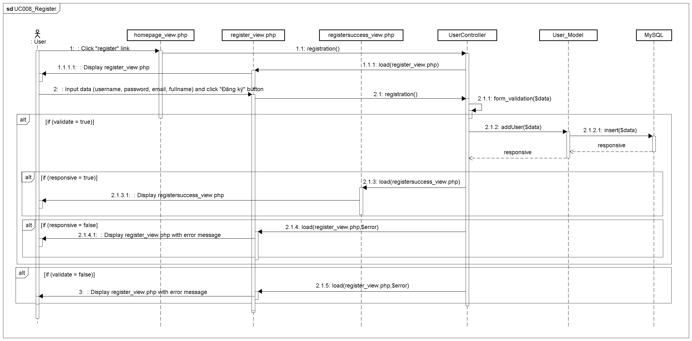
4.4.3 シーケンス図 - Sequence Diagram
レジスタ シーケンス図 - Register sequence diagram

Slide 38
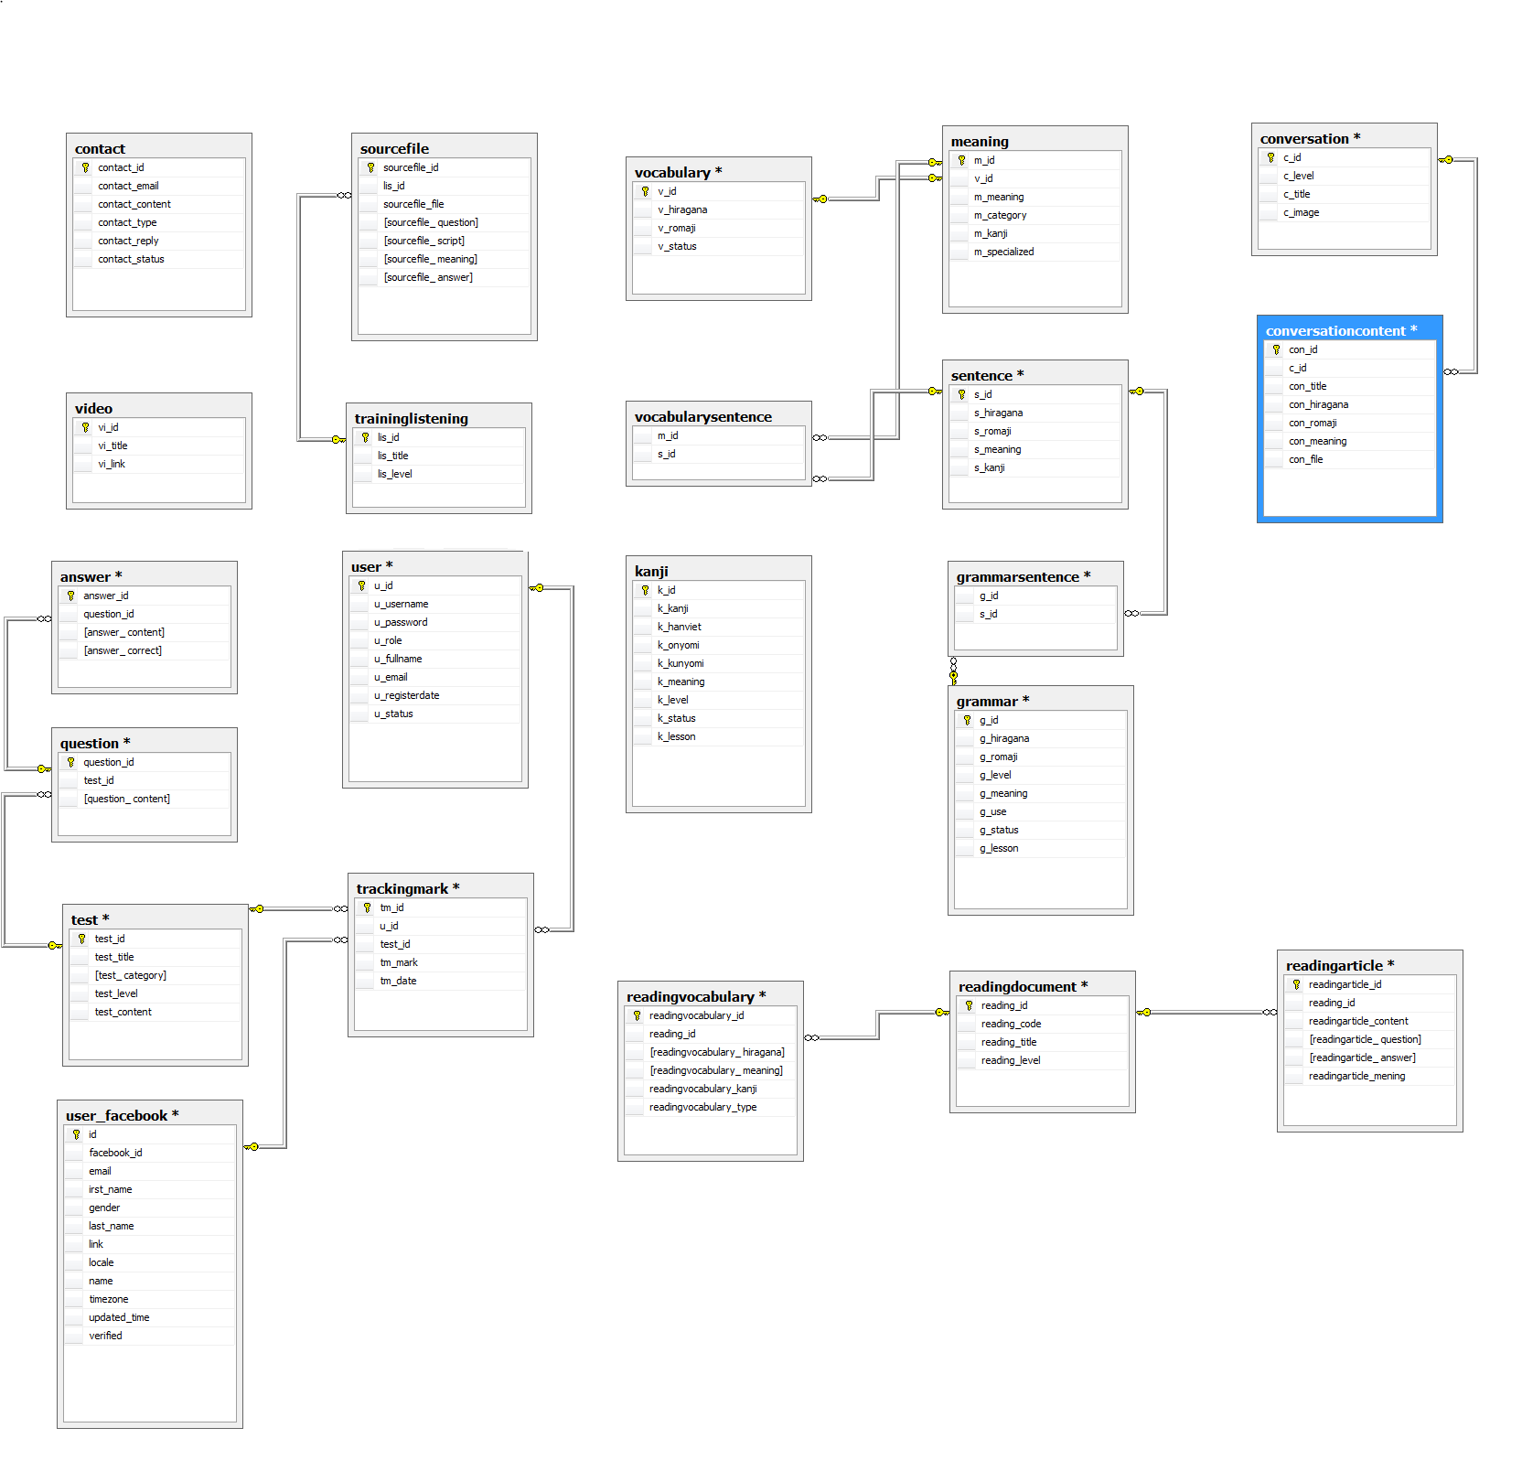
4.5 データベース設計 - Database Design

Slide 39
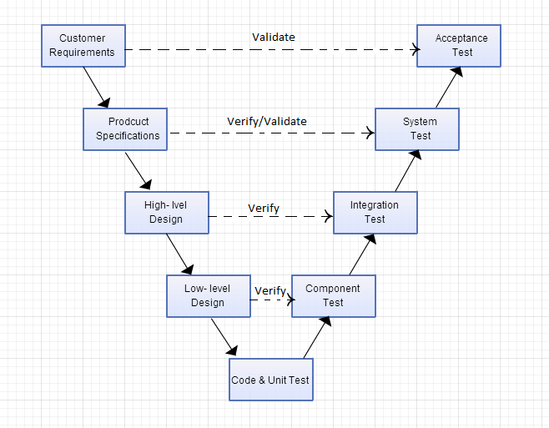
5. 品質管理 - Quality Control
Vモデル - V-model

Slide 40
5. 品質管理 - Quality Control
5.1 レビュー
Review
5.1.2 要求仕様
SRS
5.1.3 設計
Design
5.1.4 コーディング
Code
5.2 テスティング Testing
5.2.1 テストプロセス
Test Process
5.2.2 テストレポート
Test Report
5.1.5 テスト
Test Document
5.1.1 プロジェクト計画Project Plan

Slide 41



5.1 レビュー - Review
自己評価
Self-review
ピアレビュー
Peer review
グループのレビュー
Group review

Slide 42
5.1 レビュー - Review
Design Review Checklist - Low level Design (Detailed Design)
Project Code: UJD_VN
Version of the work product: v1.0
Reviewer(s): Mr. SangNV, Project team
Review date: 08/07/2014
Work product' size
Effort spent on review (man-hour): 5
Question | Yes | No | N/A | Note | Priority | Severity
CONTENT
Screen design: Does screen designs (if any) satisfy the requirements specified in other documents (SRS, Requirement, Architecture Design) ?
Does it describe GUI of the system as follows:
Does it describe/layout position of all items in GUI? | x
Does it describe processes or actions for GUI? | x
Does it describe relationship between items in GUI and modules or public functions? | x
Are the inputs and outputs for all the interfaces are sufficient and necessary? | x
デザインレビュー - Design review

Slide 43
5.1 レビュー - Review
# | Product | Quality Control Activity | #Defect
 |  |  | Plan | Actual
1 | Test case | Unit Test | 3-4(DP/KLOC) | 18
 |  | Component Test | 3-4(DP/KLOC) | 16
 |  | Integration Test | 2-3(DP/KLOC) | 9
 |  | System test | 4-6(DP/KLOC) | 13
 |  | Leakage (UAT) | 1-2
2 | Requirements | Review | 10 | 6
3 | Design | Review | 15 | 21
4 | Code | Review | 30 | 15
5 | Project Plan | Review | 10 | 3
6 | Project Schedule | Review | 10 | 6
7 | Test Plan | Review | 10 | 4
8 | Other document | Review | 15 | 10
Total |  |  |  | 121
品質レポートー - Quality report

Slide 44
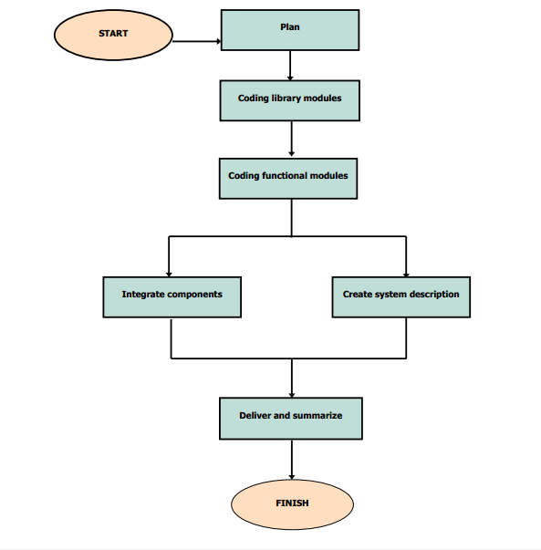
5.1.4 コーディング プロセス - Coding Process

Slide 45
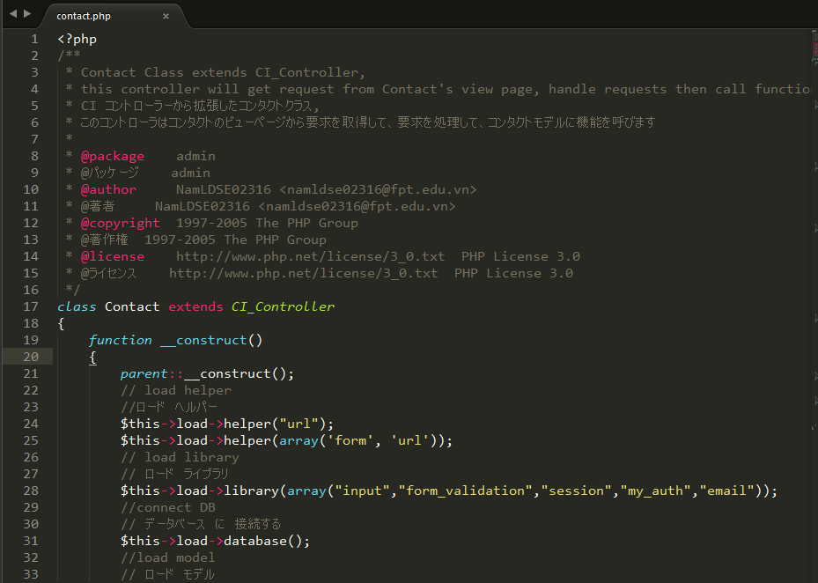
5.1.4 コーディング プロセス - Coding Process
コード規則 とコードのコメント - Code convention and Code comment

Slide 46
5.2.1 テストのプロセス - Test Process
Create Test Plan
Base on Project Plan, Project Schedule , SRS to create test plan:
Features to be tested
Acceptance Test Criteria
Environment
Schedules
Responsibilities
Risks and contingencies
…
Create Test Viewpoint
Create Test Case
Review Test Case
Execute Test
Log Bug
Re-test
Create Test Report

Slide 47
テストの計画 - Test Plan
承認 テスト 基準 - Acceptance test criteria:
Statement coverage: 97%
Branch coverage: 100%
Path coverage: 100%
テストアプローチ - Test Approach:
Unit Test: Developer
Component Test: Tester
Integration Test: Tester
System Test: Tester
Acceptance Test: Customer
テスト環境 - Test Environment:
Web :Chrome 35, CocCoc 35

Slide 48
テストの計画 - Test Plan
Milestone Task | Effort (pd) | Start Date | End Date
Create Test Plan | 6 | 16/06/2014 | 22/06/2014
Review & update TP | 2 | 23/06/2014 | 23/06/2014
Create Component Test case | 12 | 23/06/2014 | 26/06/2014
Review & update Component TC | 2 | 27/06/2014 | 27/06/2014
Create Integration Test case | 2 | 07/07/2014 | 07/07/2014
Review & Update Integration TC | 2 | 08/07/2014 | 08/07/2014
Create System Test case | 6 | 09/07/2014 | 11/07/2014
Review & Update System TC | 2 | 11/07/2014 | 11/07/2014
Execute Component test phase 1 | 1 | 16/07/2014 | 16/07/2014
Execute Component test phase 2 | 1 | 24/07/2014 | 24/07/2014
Execute Integration test phase 1 | 2 | 17/07/2014 | 17/07/2014
Execute Integration test phase 2 | 2 | 25/07/2014 | 28/07/2014
Execute System test phase 1 | 4 | 21/07/2014 | 22/07/2014
Execute System test phase 2 | 4 | 28/07/2014 | 29/07/2014
テスト節目 - Test Milestone

Slide 49
テストの計画 - Test Plan
Worker/Doer | Role | Specific Responsibilities/Comments
MinhPT | Test Leader | Manage Test Resource and assign test tasks. Create and review Test Plan. Create and review Test Case. Execute test. Create and review Test Report
TuanNN | Tester | Create and review Test Case. Execute test. Create Test view points Create and review Test Report
リソース - Resource

Slide 50
5.2.1 テストのプロセス - Test Process
Create Test Plan
Base on Test Plan, SRS to create test viewpoint.
Create Test Viewpoint
Create Test Case
Review Test Case
Execute Test
Log Bug
Re-test
Create Test Report

Slide 51
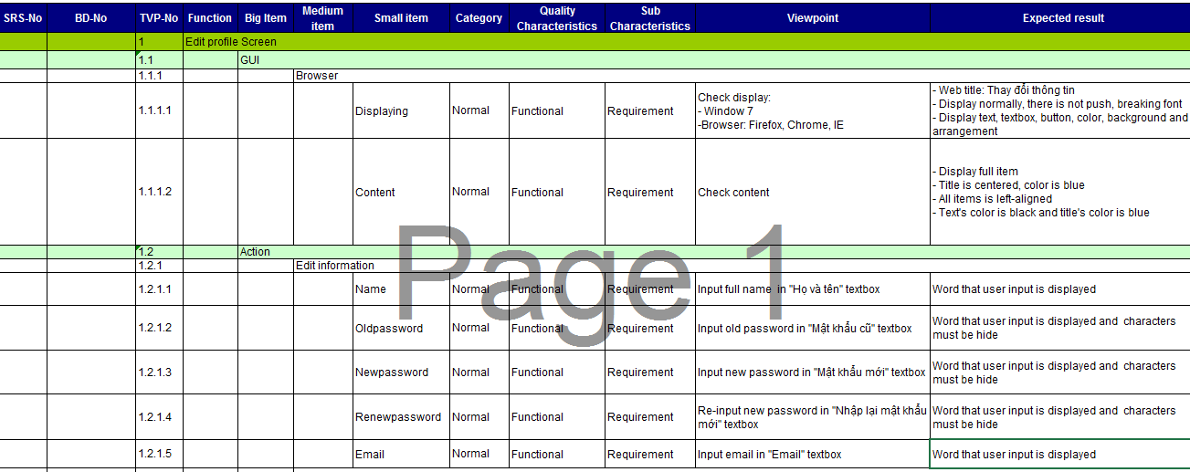
テスト観点 - Test viewpoint

Slide 52
5.2.1 テストのプロセス - Test Process
Create Test Plan
Base on SRS, test viewpoint to create test case:
Component test case
Integration test case
System test case
Create Test Viewpoint
Create Test Case
Review Test Case
Execute Test
Log Bug
Re-test
Create Test Report

Slide 53
システムテストケース - System test case
モジュール コード | Practice management
テスト要求 | This test cases were created to test Practice management module.
テスター | TuanNNSE02189
合格 | 不合格 | 未テスト | N/A | テスト項目数
0 | 0 | 229 | 0 | 229
ID | テスト項目説明 | テスト項目手順 | 期待結果 | 依存テスト項目 | 結果 | テスト 実施日 | 備考
 | Doing test
[Practice management-] | Test viewing "Kiểm tra\ Đề kiểm tra trắc nghiệm N4" form. | 1. Login the system with Member role. 2. Click "Kiểm tra\ Đề kiểm tra trắc nghiệm N4" tab in homepage. | 1. The Homepage is displayed 2. The "Đề kiểm tra N4" view form is displayed with the following informations: list of small test N4 link : - Grammar test - Listening test - Vocabulary test - Reading test | [Account Management Module- 4]
[Practice management-1] | Test viewing "Kiểm tra\ Đề kiểm tra trắc nghiệm N3" form. | 1. Login the system with Member role. 2. Click "Kiểm tra\ Đề kiểm tra trắc nghiệm N3" tab in homepage. | 1. The Homepage is displayed 2. The "Đề kiểm tra N3" view form is displayed with the following informations: list of small test N3 link: - Grammar test - Listening test - Vocabulary test - Reading test | [Account Management Module- 4]

Slide 54
5.2.1 テストのプロセス - Test Process
Create Test Plan
Developer self-review: Unit test case
Tester self-review and peer-review:
Component test case
Integration test case
System test case
Create Test Viewpoint
Create Test Case
Review Test Case
Execute Test
Log Bug
Re-test
Create Test Report

Slide 55
テストレビュー - Test case review checklist
Project Code: UJD_VN
Version of the work product: v1.0
Reviewer(s): MinhPTSE02300
Review date: 08/07/2014
Work product's size: 5 sheets
Effort spent on review (person-hour): 2
Question | Yes | No | N/A | Note | Priority
DOCUMENT CONTROL
Verify whether document control procedures have been followed by checking for the following:
Does the title page contain the document name, version number, release date and issued date? | x
Does the header and footer correctly specify the name, and version of the document? | x
Does the page – numbering scheme indicate the total number of pages in the document? | x
Is the history traceable? | x |  |  |  | Mandatory
Does it include list of reference documents? | x
Are all documents checked Spelling and Grammar in MS Word or similar tools? | x

Slide 56
5.2.1 テストのプロセス - Test Process
Create Test Plan
Tester execute test case follow phase:
Component testing
Integration testing
System testing
Create Test Viewpoint
Create Test Case
Review Test Case
Execute Test
Log Bug
Re-test
Create Test Report

Slide 57
テストケースの実行 - Execute test case
モジュール コード | Practice management
テスト要求 | This test cases were created to test Practice management module.
テスター | TuanNNSE02189
合格 | 不合格 | 未テスト | N/A | テスト項目数
0 | 0 | 229 | 0 | 229
ID | テスト項目説明 | テスト項目手順 | 期待結果 | 依存テスト項目 | 結果 | テスト 実施日 | 備考
 | Doing test
[Practice management-] | Test viewing "Kiểm tra\ Đề kiểm tra trắc nghiệm N4" form. | 1. Login the system with Member role. 2. Click "Kiểm tra\ Đề kiểm tra trắc nghiệm N4" tab in homepage. | 1. The Homepage is displayed 2. The "Đề kiểm tra N4" view form is displayed with the following informations: list of small test N4 link : - Grammar test - Listening test - Vocabulary test - Reading test | [Account Management Module- 4] | Pass | 29/7/2014
[Practice management-1] | Test viewing "Kiểm tra\ Đề kiểm tra trắc nghiệm N3" form. | 1. Login the system with Member role. 2. Click "Kiểm tra\ Đề kiểm tra trắc nghiệm N3" tab in homepage. | 1. The Homepage is displayed 2. The "Đề kiểm tra N3" view form is displayed with the following informations: list of small test N3 link: - Grammar test - Listening test - Vocabulary test - Reading test | [Account Management Module- 4] | Pass | 29/7/2014

Slide 58
5.2.1 テストのプロセス - Test Process
Create Test Plan
While executing test, Tester detect, log bug and assign to appropriate developer.
Create Test Viewpoint
Create Test Case
Review Test Case
Execute Test
Log Bug
Re-test
Create Test Report

Slide 59
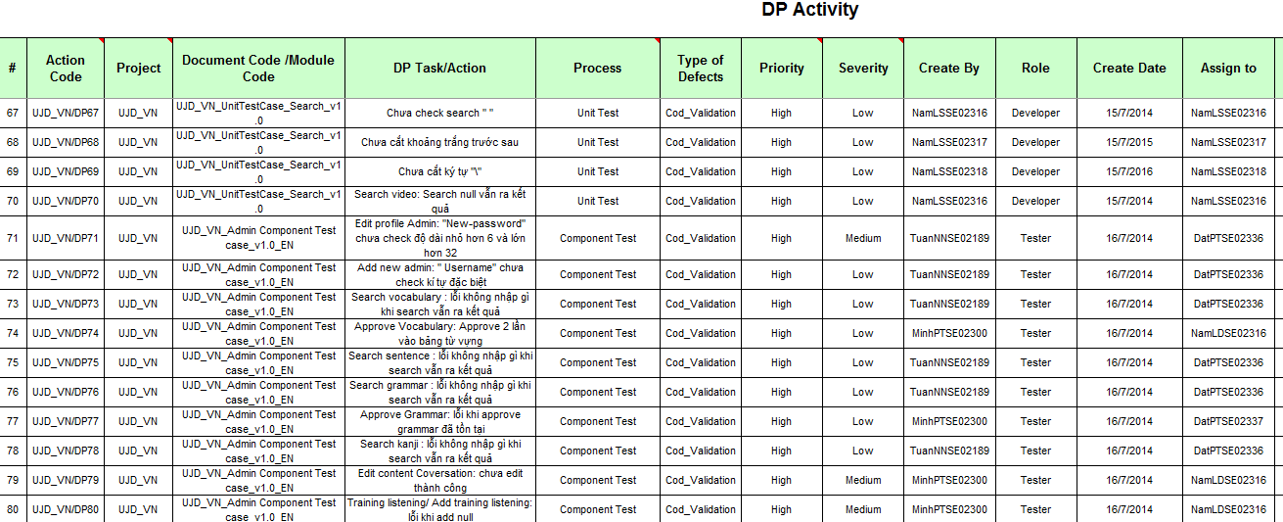
不具合管理 - Defect log management

Slide 60
5.2.1 テストのプロセス - Test Process
Create Test Plan
When Developer fixed bug, Tester re-test until bug was fixed successfully, then change defect of status to Closed.
Create Test Viewpoint
Create Test Case
Review Test Case
Execute Test
Log Bug
Re-test
Create Test Report

Slide 61
5.2.1 テストのプロセス - Test Process
Create Test Plan
Tester has responsibility to write test report for each test phase . Finish testing phase, Test leader create Test report
Create Test Viewpoint
Create Test Case
Review Test Case
Execute Test
Log Bug
Re-test
Create Test Report

Slide 62
5.2.2 テストのレポート - Test Report
Phase | # Test cases Planned (TC/KLOC) | #Defects Planned (DP/KLOC) | #Test cases Actual | #Defects Actual | % Tests Executed | % Tests Passed | % Tests Fail
Unit Test | 40 | 3 -4 | 542 | 18 | 100% | 100% | 0%
Component Test | 40 | 3 -4 | 751 | 16 | 100% | 100% | 0%
Integration Test | 30 | 2 -3 | 284 | 9 | 100% | 100% | 0%
System Test | 60 | 4 -6 | 1493 | 13 | 100% | 100% | 0%
Total |  |  | 3070 | 56

Slide 63
5.2.2 テストのレポート - Test Report
Phase | Round 1 |  |  |  | Round 2
 | Pass | Fail | Untested | Bug | Pass | Fail | Untested | Bug
Unit Test | 425 | 14 | 0 | 14 | 99 | 4 | 0 | 4
Component Test | 465 | 12 | 0 | 12 | 270 | 4 | 0 | 4
Integration Test | 112 | 6 | 0 | 6 | 163 | 3 | 0 | 3
System Test | 990 | 6 | 0 | 6 | 490 | 7 | 0 | 7
Total | 1992 | 38 | 0 | 38 | 1022 | 18 | 0 | 18

Slide 64
5.2.2 テストのレポート - Test Report
Defects | Logged | %Closed | %Invalid | %Open
Critical | 0 | 0% | 0% | 0%
High | 0 | 0% | 0% | 0%
Medium | 11 | 100% | 0% | 0%
Low | 45 | 100% | 0% | 0%
Total | 56 | 100% | 0% | 0%
不具合レポート - Defect Report

Slide 65
6. プロジェクト結果 – Project Result
Main objective | Develop a system which will provide to users functionality to search and reading document online and the other users log-in and do the test.
Purpose | Provide a UJD_VN online on website.
Source Repository | https://japanesedictionary.googlecode.com/svn/trunk/
 | Plan | Actual
Start Date | 12/05/2014 | 12/05/2014
End Date | 22/08/2014 | 30/08/2014
Releases version | 1.0 | 1.0
Duration | 75 | 81
Effort (person-day) | 300 | 308
Test cases | 2600 | 2528
Defects | 300 - 400 | 121
Document pages | 700 pages | 1200 pages
Lines of code | ~20000 | ~ 24000
比較 - Comparison

Slide 66
制限と期待 – Limitation & Expectation
現在の制限 - Current Limitations | 将来に期待 - Expectation in Future
Have not Mobile version Not support English language Not have money for up load website to Host | Upload to host that user easy to use Get attracting from user who care Japanese Commercialized product

Slide 67
学んだ教訓 - Lessons Learnt
日本のスタイル - Japanese style
チームワーク - Working in group
実際に知識を入れます - Putting knowledge in practice
新技術でコーディングスキルを改善します - Improve coding skill with new technology

Slide 68
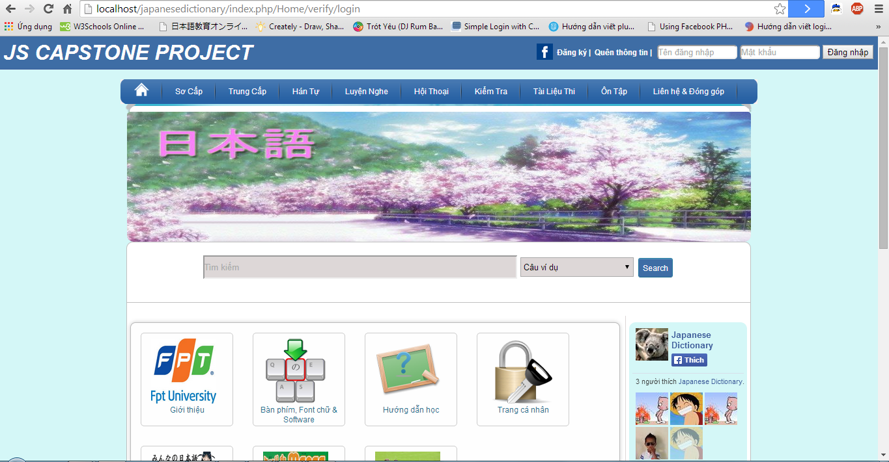
7. デモ - Demo

Slide 69

8. 質問と回答 - Q & A

Slide 70


